Slide 1


CAR PARKING
RESERVATION SYSTEM

Slide 2
ABSTRACT
The main purpose of "car parking reservation system" is to take car reservation to the next level and fix the existing drawbacks and loopholes of the current model present and make the experience ease for the everyone

Slide 3
PROBLEM
STATEMENT
·In current tour and travel recommendation system, there is too much manual and paperwork used book the tickets.
·It becomes very difficult to manage record of all tourists manually which results in heap of files. So, there is always a risk of loss of information due to various reasons.
Also, there is imbalancebetween the manpoweravailability which resultsin inaccuracy and delay in confirmation of booking status

Slide 4
EXISTING SYSTEM
The car parking reservation system should be updated regularly .
Geting parking slots is very hard with the old system becouse it lacks database

Slide 5
PROPOSED SYSTEM
IN THE OLD SYSTEM DUE TO THE LACK OF DATABASE THE PARKING SYSTEM
THE NEW PROPOSED SYSTEM HAS A VAST DATABASE SO THAT IT HELPS IN AI DETECTION AND STORES HE DATA

Slide 6
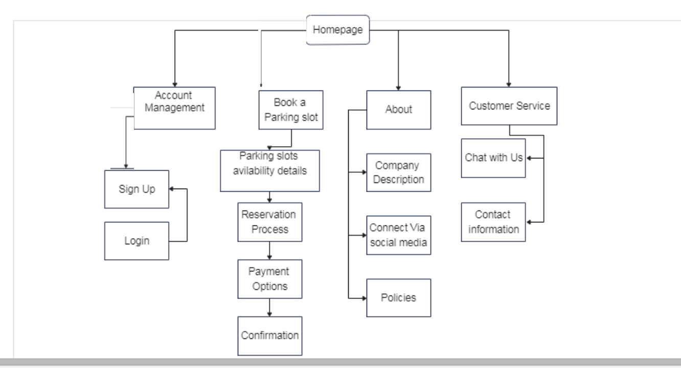
Architecture Diagram

Slide 7
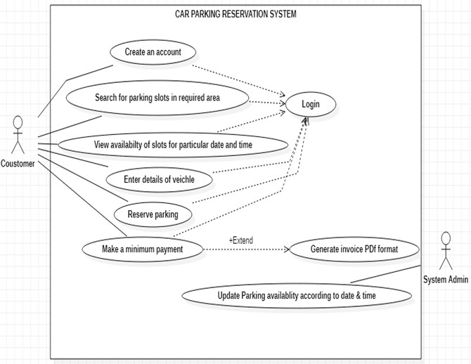
Use Case Diagram

Slide 8
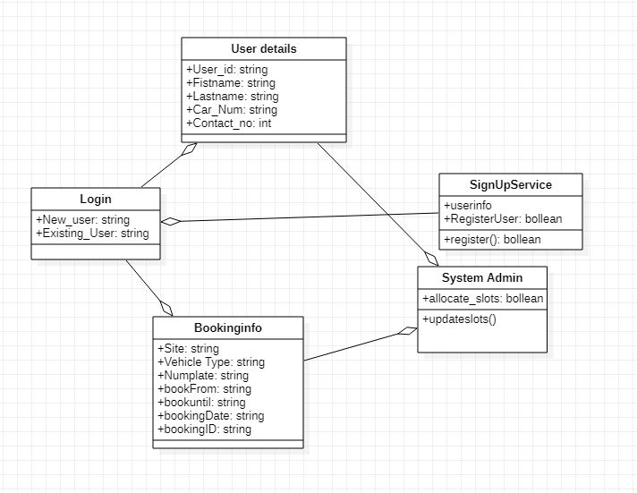
Class Diagram

Slide 9
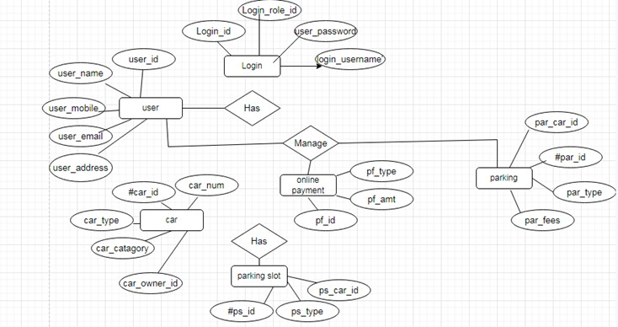
ER Diagram

Slide 10
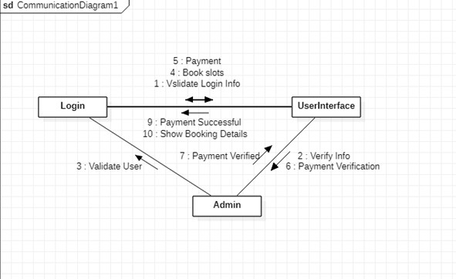
Collaboration Diagram

Slide 11
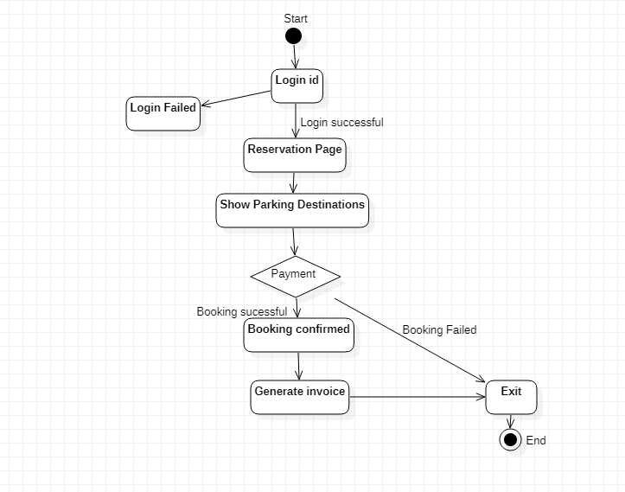
Activity Diagram

Slide 12
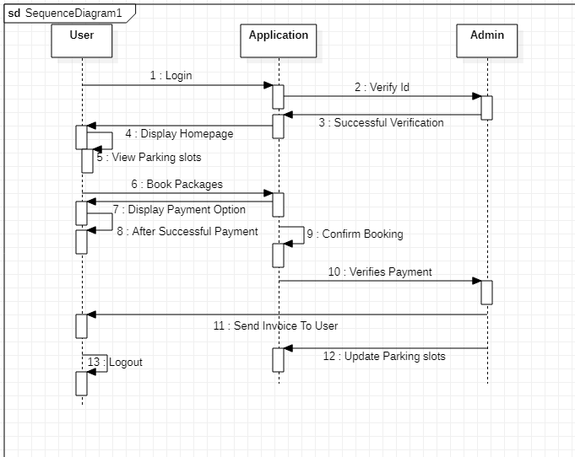
Sequence Diagram

Slide 13
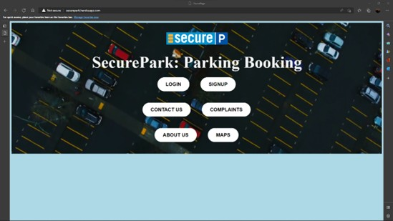
DEMOS

Slide 14
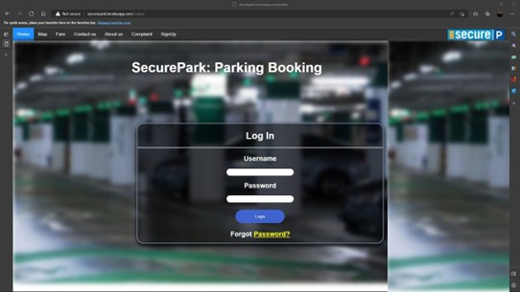
LOGIN PAGE

Slide 15


Slide 16
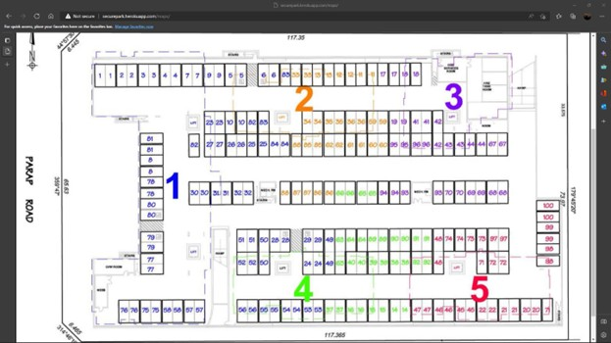

Slide 17
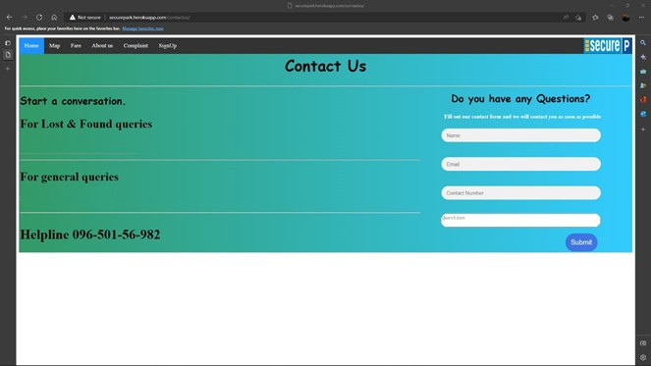

Slide 18

Conclusion
The project aims to design and implement a platform where the user can pre reserve their parking slot in required places.

Slide 19
Thank You

